Slide 1
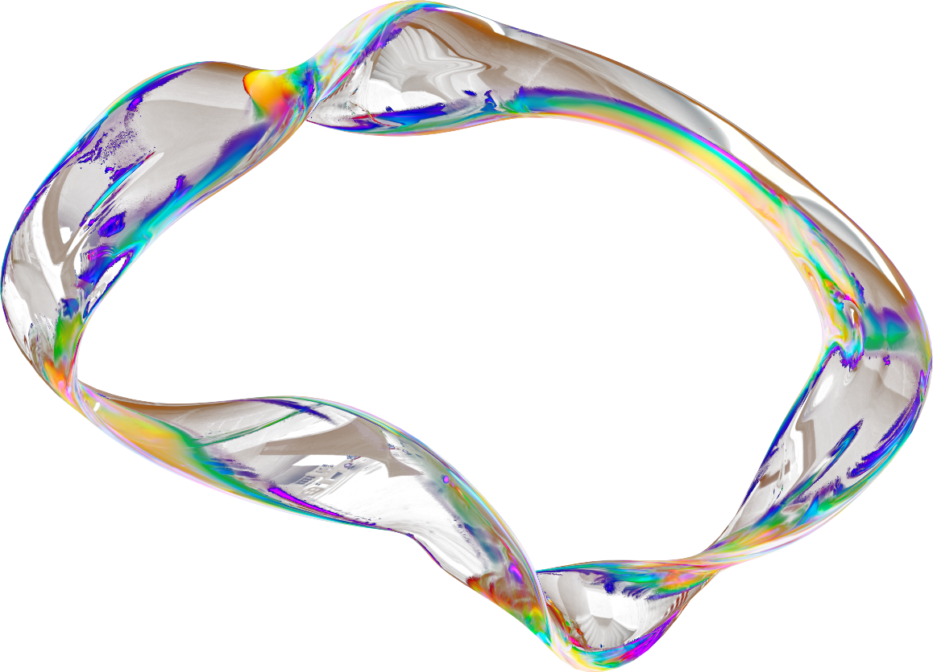

CS-325- MR. ISRAR AHMED
MVC ARCHITECTURE
Presented by:
Mohid Ali
Muhammad Abubakar

Slide 2


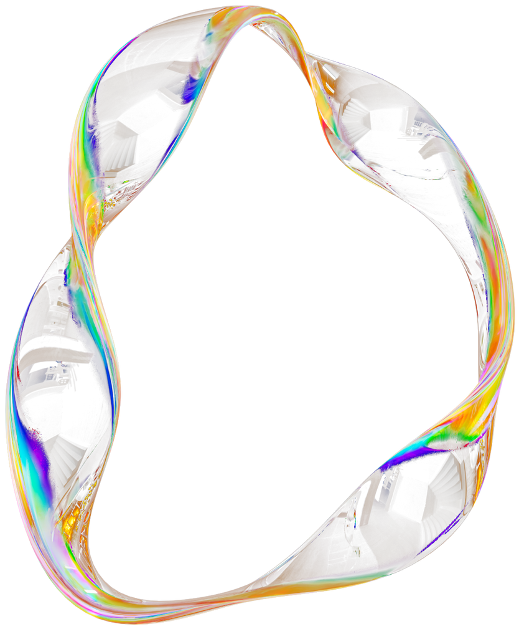
TODAY'S AGENDA
1
Introduction to MVC
6
Insights from Research Study
2
Problem Statement
7
Advantages/Disadvantages of MVC
3
The Model Component
8
Activity
4
Live MVC Use Case
9
Q&A
5
Why Developers Use MVC

Slide 3
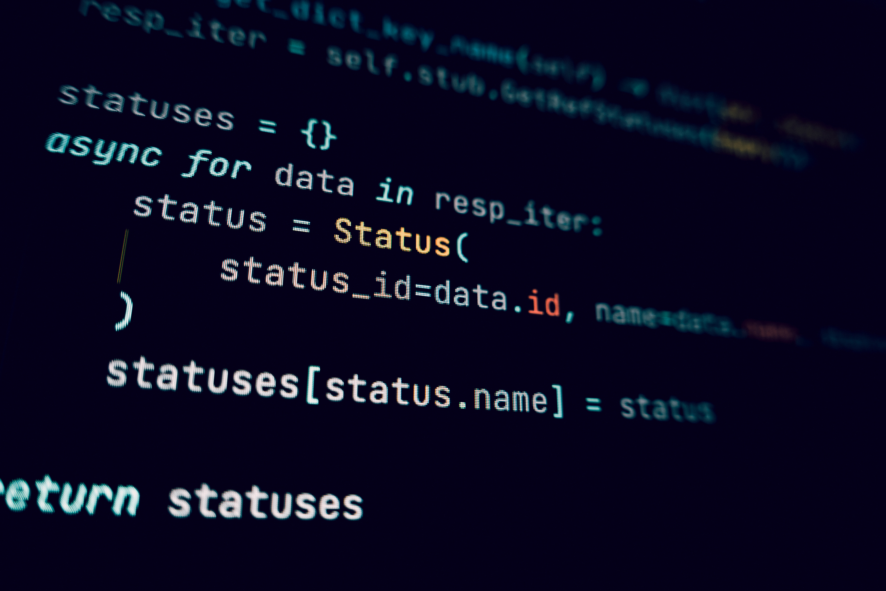
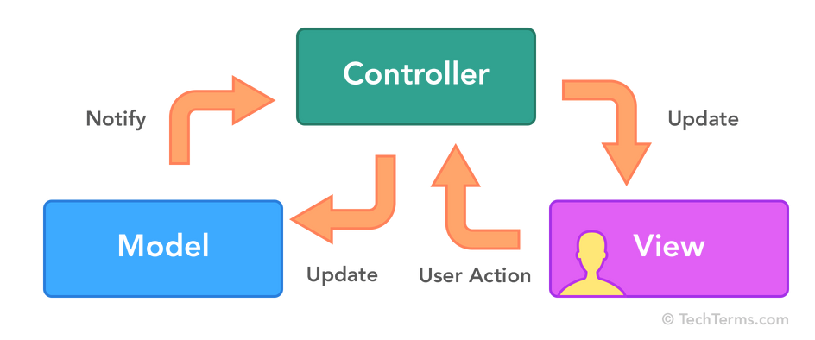
INTRODUCTION
What is MVC?
A software design pattern that separates an app into Model, View, and Controller
Purpose: clean structure, easier maintenance, better scalability

Slide 4
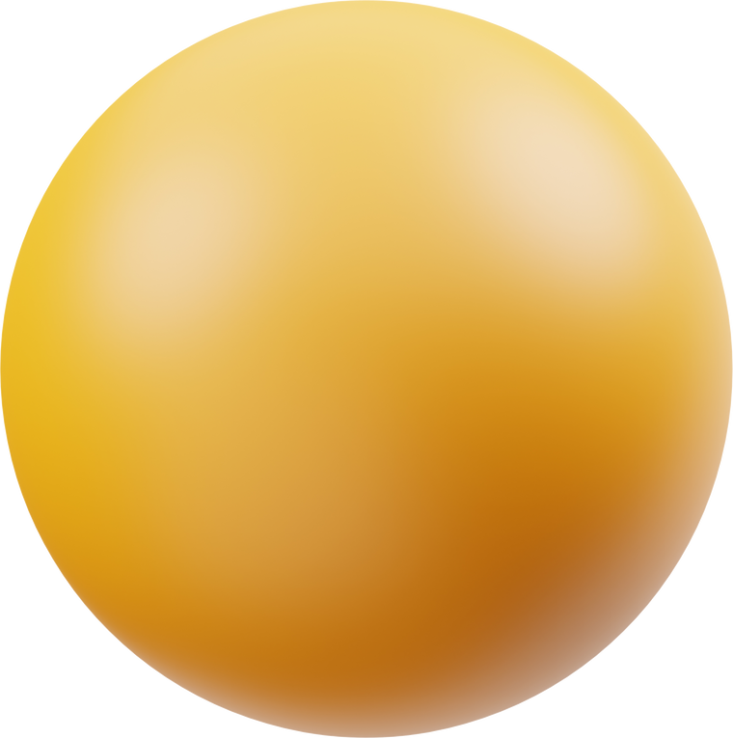
Increasing Application Complexity
Modern applications are becoming more complex, with growing business logic, diverse user interfaces, and rapidly evolving features making it difficult to maintain clean, organized codebases.
Poor Separation of Responsibilities
Without a structured architecture, developers often mix UI, logic, and data operations in the same files, leading to tightly coupled components, slower development, and harder debugging.
PROBLEM STATEMENT
Difficulty Scaling and Maintaining Code
As applications grow, the lack of modularity results in unstable updates, reduced developer productivity, and significant technical debt, slowing down innovation and feature delivery.

Slide 5
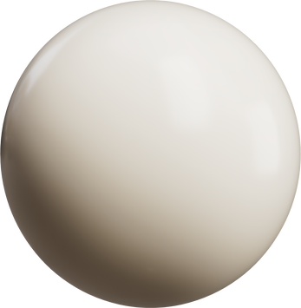

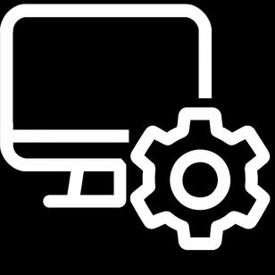
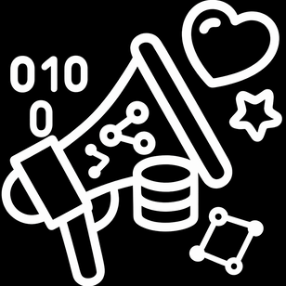
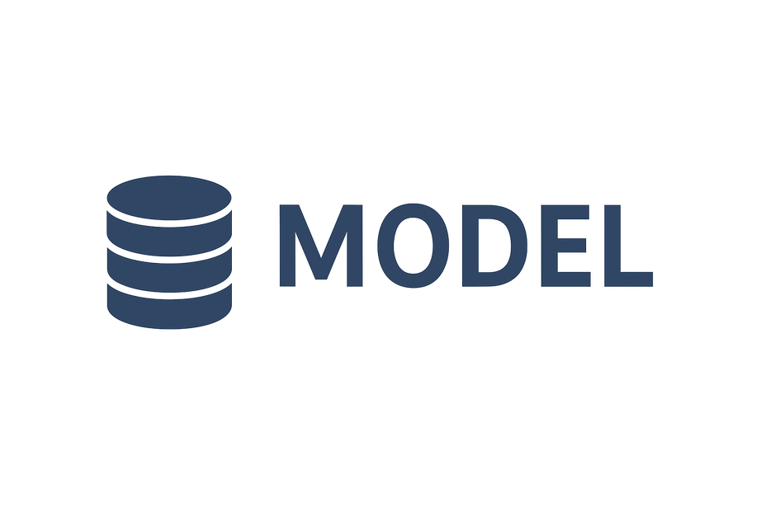
THE MODEL COMPONENT
Handles data, business logic, and rules
Defines how data is stored and manipulated
Independent of the UI

Slide 6
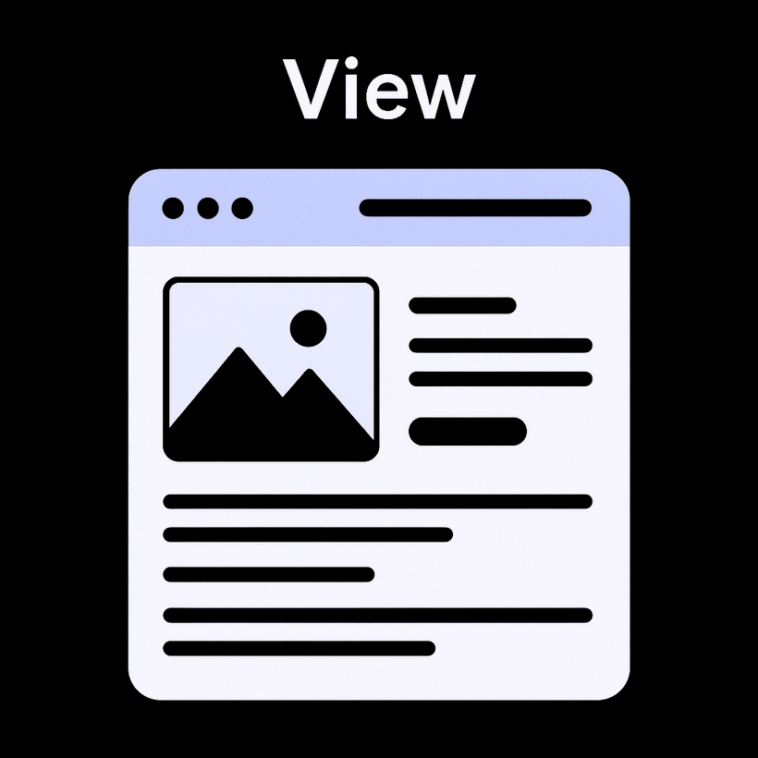

THE VIEW COMPONENT
RESPONSIBLE FOR THE USER INTERFACE
DISPLAYS DATA FROM THE MODEL
CONTAINS NO BUSINESS LOGIC

Slide 7
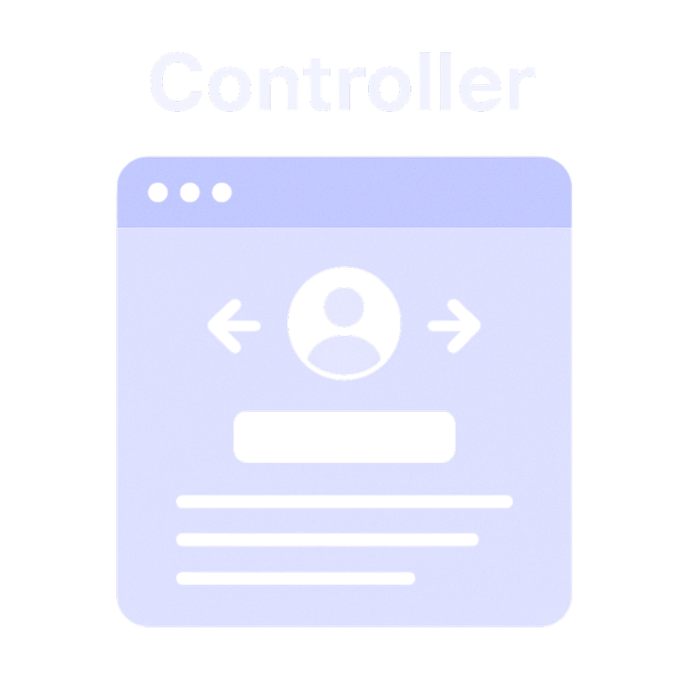

THE CONTROLLER COMPONENT
ACTS AS THE MEDIATOR
RECEIVES USER INPUTS AND TRIGGERS MODEL UPDATES
DECIDES WHICH VIEW TO RENDER

Slide 8
LIVE MVC USE CASE
TASK MANAGER

Slide 9
WHY DEVELOPERS USE MVC
Better Code Organization & Separation of Concerns
Separation of concerns
Parallel development
Reusability of components
Maintainability
Scalability for large apps
Faster Development & Easier Maintenance
Reusability, Flexibility & Testability

Slide 10

KEY ADVANTAGES
Code Reuse & Modularity
Parallel Development
Because the Model is decoupled, you can reuse it in other projects or across modules.
As noted in the preprint, front-end and back-end teams can work simultaneously, speeding up delivery.
Maintainability & Testability
Adaptability
With MVC, it's easier to write unit tests for Models (business logic) separately from Views.
It’s flexible enough to integrate with AI / ML, according to recent research.

Slide 11

KEY DISADVANTAGES
Complexity Overhead
Tight Coupling Risk
For small apps, splitting into three layers may feel like over-engineering.
If not designed carefully, Controllers can become bloated (“fat controllers”) with too much logic.
Evolving Needs
Overhead in Rendering
As applications evolve (e.g., real-time apps or single-page apps), MVC may not always be the best fit.
Passing data through Controller to Views can introduce latency.

Slide 12
INSIGHTS FROM RESEARCH STUDY
Mansel research documents, showing MVC is deeply studied
Annual research growth rate: ~7.47%
MVC heavily used in Java, .NET, JS frameworks
Adoption in finance, e-commerce, and enterprise systems
Prof. Sabina Necula
Alexandru Ioan Cuza University
Exploring The Model-View-Controller (MVC) Architecture: A Broad Analysis of Market and Technological Applications

Slide 13
THOUGHT EXPERIMENT
IMAGINE YOU WERE BUILDING A REAL ESTATE LISTING APP. HOW WOULD YOU DESIGN YOUR MVC?
WHAT WOULD YOUR MODEL LOOK LIKE?
WHAT VIEWS WOULD YOU NEED?
WHAT CONTROLLERS WOULD MEDIATE?

Slide 14
Q&A / DISCUSSION
FEEL FREE TO ASK ANY QUESTIONS!

Slide 15
CS-325- MR. ISRAR AHMED
THANK YOU
for your time and attention
Presented by:
Mohid Ali
Muhammad Abubakar

